Slide 1
Azure Security Briefing
Subtitle or speaker name

Slide 2


Module 01 Identity and Access
Azure Active Directory
Azure AD Identity Protection
Enterprise Governance
Azure AD Privileged Identity Management
Hybrid Identity
Module Labs

Slide 3
Azure Active Directory

Slide 4

Azure Active Directory (Azure AD)
Azure AD Features
Azure AD vs AD DS
Roles for Azure AD
Azure AD Domain Services
Azure AD Users
Azure AD Groups
Azure MFA Concepts
Enabling MFA
MFA Settings
Notes:
Manage identity and access (30-35%)
Manage Azure Active Directory identities
Configure security for service principals
Manage Azure AD directory groups
Manage Azure AD users
Configure secure access by using Azure AD
Implement Conditional Access policies including Multi-Factor Authentication (MFA)

Slide 5
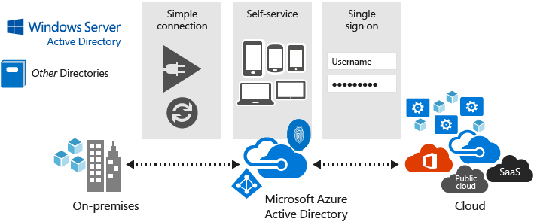
Azure Active Directory Features
Microsoft’s multi-tenant cloud-based directory and identity management service
Identity management capabilities and integration
Integrates with Windows Server Active Directory
Provides SSO access
Notes:
Azure Active Directory Documentation - https://docs.microsoft.com/en-us/azure/active-directory/
The student content also discusses editions and pricing.
✔️ If you are an Office365, Azure or Dynamics CRM Online customer, you might not realize that you are already using Azure AD. Every Office365, Azure and Dynamics CRM tenant is already an Azure AD tenant. Whenever you want you can start using that tenant to manage access to thousands of other cloud applications Azure AD integrates with.

Slide 6









Azure AD versus Active Directory Domain Services (AD DS)
Windows Server
Active Directory
Domain Services
Azure
Active Directory
Auth
Kerberos
NTLM
Auth
SAML
OpenID Connect
WS-Federation
Azure
Apps
Apps
Users & Groups
Authentication
+
Authorization
Local
Cloud
Azure
resources
Office
365
On-premises
Service | Authentication | Structure | What it's used for
Azure Active Directory | Includes SAML, OpenID Connect (based on OAuth), WS-Federation | Tenants | Internet-based services and applications like Office 365, Azure services, and third-party SaaS applications
Active Directory Domain Services | Kerberos, NTLM | Forests, domains, organizational units | Authentication and authorization for on-premises printers, applications, file services, and more

Slide 7
Roles for Azure AD (sample)
Built-in Role | Description
Global Administrator | Users with this role have access to all administrative features in Azure Active Directory
Security Administrator | Users with this role have permissions to manage security-related features in the Microsoft 365 Security Center, Security Center, Azure Active Directory Identity Protection, Azure Information Protection, and Office 365 Security & Compliance Center
Billing Administrator | Makes purchases, manages subscriptions, manages support tickets, and monitors service health
Global Reader | Users in this role can read settings and administrative information across Microsoft 365 services but can't take management actions.
Notes:
Administrator role permissions in Azure Active Directory - https://docs.microsoft.com/en-us/azure/active-directory/users-groups-roles/directory-assign-admin-roles
NOTE – This is just a sample set of roles in Azure AD. Open the Azure Portal and go to Azure AD and select Roles and Administrators to get a complete list.

Slide 8
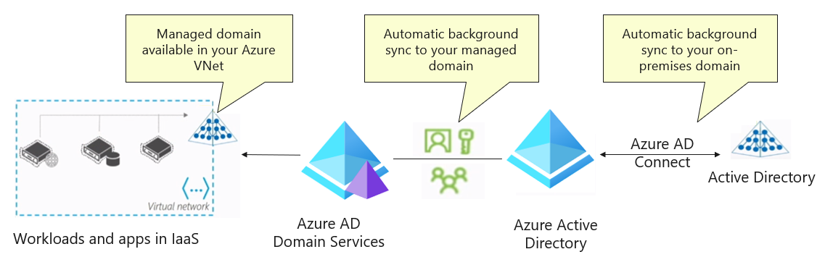
Azure AD Domain Services
Integrated with Azure AD
Use your corporate credentials and passwords
NTLM and Kerberos authentication
High availability and simple deployment experience
Notes:
What is Azure Active Directory Domain Services? - https://docs.microsoft.com/en-us/azure/active-directory-domain-services/overview
Azure Active Directory Domain Services (Azure AD DS) - Provides managed domain services with a subset of fully-compatible traditional AD DS features such as domain join, group policy, LDAP, and Kerberos / NTLM authentication.
- Azure AD DS integrates with Azure AD, which itself can synchronize with an on-premises AD DS environment.
This ability extends central identity use cases to traditional web applications that run in Azure as part of a lift-and-shift strategy.
Features
•Simple deployment
•Single managed domain per Azure AD directory
•High availability with fault tolerance
•Automatic health detection & remediation
•Auto-sync from AAD – use same users, groups & passwords
•On-premises SIDs are synced to SIDHistory in your managed domain
•Domain join
•Windows Integrated Authentication (Kerberos, NTLM)
•LDAP bind and LDAP read
•Secure LDAP (including over internet)
•Create custom OUs
•Administer DNS
•Group Policy

Slide 9
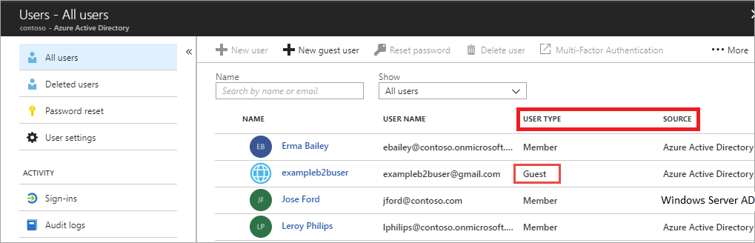
Azure AD Users
All users must have an account
The account is used for authentication and authorization
Types of users: Azure AD, Active Directory, Guest, B2C, and B2B
Notes:
Add or delete users using Azure Active Directory - https://docs.microsoft.com/en-us/azure/active-directory/fundamentals/add-users-azure-active-directory?context=azure/active-directory/users-groups-roles/context/ugr-context
In Azure AD, all users who require access to resources must have a user account. A user account is a synced AD DS object or an Azure AD user object that contains all the information that's required to authenticate and authorize the user during the sign‑in process and build the user's access token. To view the Azure AD users, simply access the All users blade. Take a minute to access the Portal and view your users. Notice the User Type and Member columns.
✔️ Have you given any thought as to the type of users you will need?

Slide 10
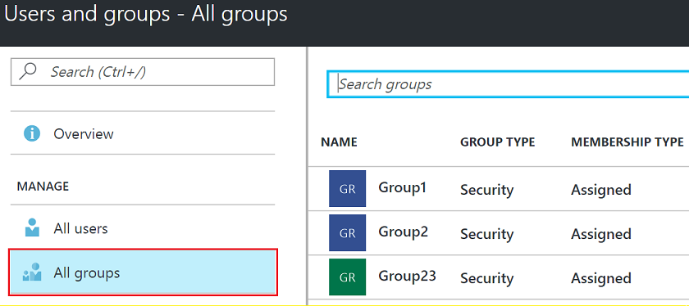
Azure AD Groups
Group Types
Security groups
Microsoft 365 groups
Assignment Types
Assigned
Dynamic User
Dynamic Device (Security groups only)
Notes:
Users, groups, licensing, and roles for large organizations - https://docs.microsoft.com/en-us/azure/active-directory/users-groups-roles/directory-overview-user-model
A group helps organize users to make it easier to manage permissions. Groups can be easily added through the portal. There are two types of groups: security groups and distribution groups.
✔️ Have you given any thought to which groups you need to create? How will you assign users to groups?

Slide 11
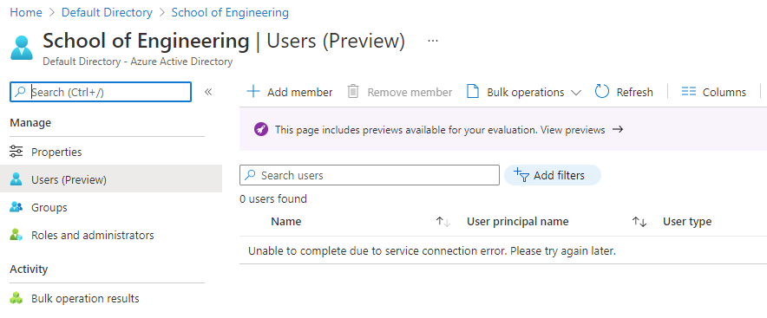
Administrative Units in Azure AD
Admin Unit Members
Users
Groups
Usage
Delegate administration of AD resources to specific person or role
Configure using
PowerShell / MS Graph
Azure AD portal
M365 Admin Center
Notes:
Source –- Administrative units in Azure Active Directory | Microsoft Docs and
Roles and the Description of what they can be used for:
Authentication Administrator - Has access to view, set, and reset authentication method information for any non-admin user in the assigned administrative unit only.
Groups Administrator - Can manage all aspects of groups and groups settings, such as naming and expiration policies, in the assigned administrative unit only.
Helpdesk Administrator - Can reset passwords for non-administrators and Helpdesk administrators in the assigned administrative unit only.
License Administrator - Can assign, remove, and update license assignments within the administrative unit only.
Password Administrator - Can reset passwords for non-administrators and Password Administrators within the assigned administrative unit only.
User Administrator - Can manage all aspects of users and groups, including resetting passwords for limited admins within the assigned administrative unit only.

Slide 12
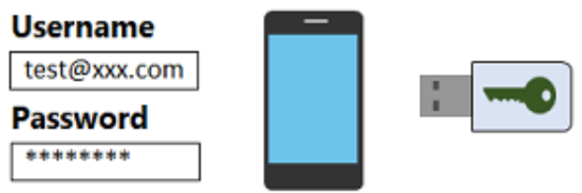

Azure MFA Concepts
The security of MFA two-step verification lies in its layered approach
Authentication methods include:
Something you know (typically a password)
Something you have (a trusted device that is not easily duplicated, like a phone)
Something you are (biometrics)
Notes:
Multi-factor authentication - https://azure.microsoft.com/en-us/services/multi-factor-authentication/
Using MFA increases identity security by limiting the impact of credential exposure. To fully authenticate, an attacker who has a user's password would also need to have possession of their phone or their fingerprint, for example. Authentication with only a single factor is insufficient and, without MFA, an attacker would be unable to use those credentials to authenticate. MFA should be enabled wherever possible as MFA adds enormous benefits to security.
Azure Multi-Factor Authentication (MFA) is Microsoft's two-step verification solution. Azure MFA helps safeguard access to data and applications while meeting user demand for a simple sign-in process. It delivers strong authentication via a range of verification methods, including phone call, text message, or mobile app verification.
MFA allows the provider of the request service to validate that the user really is real person, not a bot and, they have the device with them and, that they could provide any additional information that we might need from that environment.
✔️ How many methods can you identify in this graphic? Can you think of any ways to overcome the two-step authentication? For example, phishing, stolen devices, or malware.

Slide 13
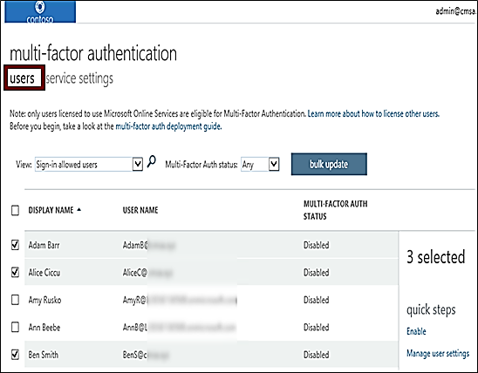
Enabling MFA
Select the users that you want to modify and enable for MFA
User states can be Enabled,
Enforced, or Disabled
On first-time sign-in, after MFA has been enabled, users are prompted to configure their MFA settings
Azure MFA is included free of charge for global administrator security
Notes:
Enable per-user Azure Multi-Factor Authentication to secure sign-in events - https://docs.microsoft.com/en-us/azure/active-directory/authentication/howto-mfa-userstates
There are two ways to secure user sign-in events by requiring multi-factor authentication in Azure AD. The first, and preferred, option is to set up a Conditional Access policy that requires multi-factor authentication under certain conditions. The second option is to enable each user for Azure Multi-Factor Authentication. When users are enabled individually, they perform multi-factor authentication each time they sign in (with some exceptions, such as when they sign in from trusted IP addresses or when the remembered devices feature is turned on).
✔️ On first-time sign-in, after MFA has been enabled, users are prompted to configure their MFA settings. For example, if you enable MFA so that users must use a mobile device, users will be prompted to configure their mobile device for MFA. Users must complete those steps, or they will not be permitted to sign in, which they cannot do until they have validated that their mobile device is MFA-compliant.

Slide 14
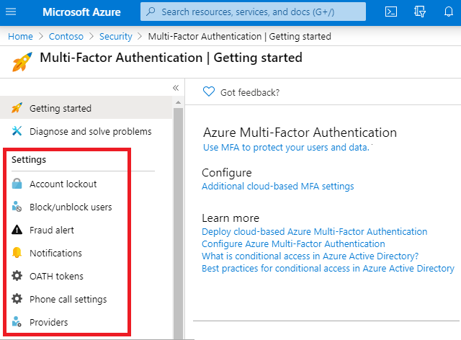
MFA Settings
Account Lockout – temporarily lock accounts if too many denied authentication attempts occur.
Block/Unblock Users – block specific users from being able to receive MFA requests.
Fraud Alerts - Users can report fraudulent attempts to access their resources
Notes:
Configure Azure Multi-Factor Authentication settings - https://docs.microsoft.com/en-us/azure/active-directory/authentication/howto-mfa-mfasettings
Feature and description
Account lockout - Temporarily lock accounts from using Azure AD Multi-Factor Authentication if there are too many denied authentication attempts in a row. This feature only applies to users who enter a PIN to authenticate. (MFA Server)
Block/unblock users - Block specific users from being able to receive Azure AD Multi-Factor Authentication requests. Any authentication attempts for blocked users are automatically denied. Users remain blocked for 90 days from the time that they are blocked or they're manually unblocked.
Fraud alert - Configure settings that allow users to report fraudulent verification requests.
Notifications - Enable notifications of events from MFA Server.
OATH tokens - Used in cloud-based Azure AD MFA environments to manage OATH tokens for users.
Phone call settings - Configure settings related to phone calls and greetings for cloud and on-premises environments.
Providers - This will show any existing authentication providers that you may have associated with your account. New authentication providers may not be created as of September 1, 2018

Slide 15
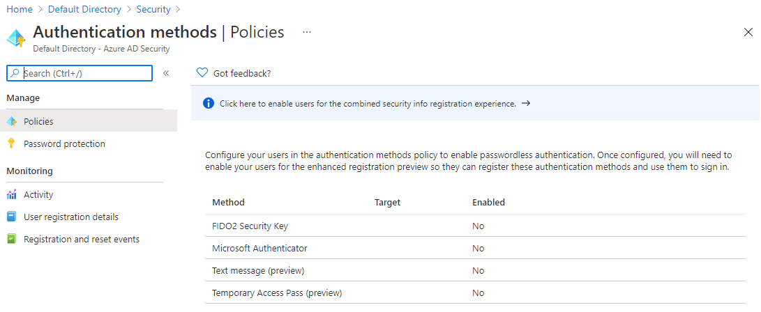
Passwordless
Log in without using a password, ever.
Increased security
Better user experience
More insights with logs and audits
Notes:
https://docs.microsoft.com/en-us/azure/active-directory/authentication/howto-authentication-passwordless-phone
https://docs.microsoft.com/en-us/azure/active-directory/authentication/howto-authentication-passwordless-security-key
Passwordless launch blog - Passwordless authentication is now generally available! - Microsoft Tech Community
Microsoft offers three passwordless authentication options that cover many scenarios. These methods can be used in tandem:
Windows Hello for Business is best for users on their dedicated Windows computers.
Security key sign-in with FIDO2 Security keys is especially useful for users who sign in to shared machines like kiosks, in situations where use of phones is restricted, and for highly privileged identities.
Phone sign in with the Microsoft Authenticator app is useful for providing a passwordless option to users with mobile devices. The Authenticator app turns any iOS or Android phone into a strong, passwordless credential by allowing users to sign into any platform or browser. Users sign in by getting a notification to their phone, matching a number displayed on the screen to the one on their phone, and then using their biometric data or PIN to confirm.
FIDO2 Smartcards and Temporary Access Pass are both in preview.
Benefits of passwordless authentication
Increased security - Reduce the risk of phishing and password spray attacks by removing passwords as an attack surface.
Better user experience - Give users a convenient way to access data from anywhere. Provide easy access to applications and services such as Outlook, OneDrive, or Office while mobile.
Robust insights - Gain insights into users passwordless activity with robust logging and auditing.

Slide 16
Demonstrations: Azure Active Directory
Navigating Azure (required)
Azure AD Licensing
Users and Groups
Multi-Factor Authentication
An alternative to the Navigating Azure demonstration is the MS Learn Manage services with the Azure portal module
Notes:
To be successful in the labs, students need a basic understanding of how to use the Portal. They are need to know how to access the lab environment and any best practices you have about doing the labs. There is demonstration covering these concepts there is also a MS Learn module - https://docs.microsoft.com/en-us/learn/modules/tour-azure-portal/
In the virtual classroom consider having the students join you in doing the demonstrations. Or you could have someone share their screen and be coached through the demonstration. Consider which demonstrations to provide given your student’s interests and the labs they will be assigned.

Slide 17
Additional Study – Azure Active Directory
Module Review Questions
Microsoft Learn Modules (docs.microsoft.com/Learn)
Secure your identities by using Azure Active Directory
Manage users and groups in Azure Active Directory
Create Azure users and groups in Azure Active Directory (Exercise)
Secure Azure Active Directory users with Multi-Factor Authentication (Exercise)
Secure your cloud resources with access control
Notes:
For students who may be new to Azure or are struggling with the labs consider having them use their lab time going through the Learn modules instead.
(docs.microsoft.com/Learn)
Secure your identities by using Azure Active Directory - https://docs.microsoft.com/en-us/learn/modules/intro-to-azure-ad/
Manage users and groups in Azure Active Directory - https://docs.microsoft.com/en-us/learn/modules/manage-users-and-groups-in-aad/
Create Azure users and groups in Azure Active Directory - https://docs.microsoft.com/en-us/learn/modules/create-users-and-groups-in-azure-active-directory/
Secure Azure Active Directory users with Multi-Factor Authentication - https://docs.microsoft.com/en-us/learn/modules/secure-aad-users-with-mfa/
Secure your cloud resources with access control - https://docs.microsoft.com/en-us/learn/modules/cmu-secure-cloud-resources/

Slide 18

Azure AD Identity Protection

Slide 19




Azure AD Identity Protection
Azure AD Identity Protection
Risk Events
User Risk Policy
Sign-in Risk Policy
Azure AD Conditional Access
Conditions
Access Reviews
Notes:
Manage identity and access (30-35%)
Configure secure access by using Azure AD
Implement Conditional Access policies including Multi-Factor Authentication (MFA)
Configure Azure AD identity protection

Slide 20
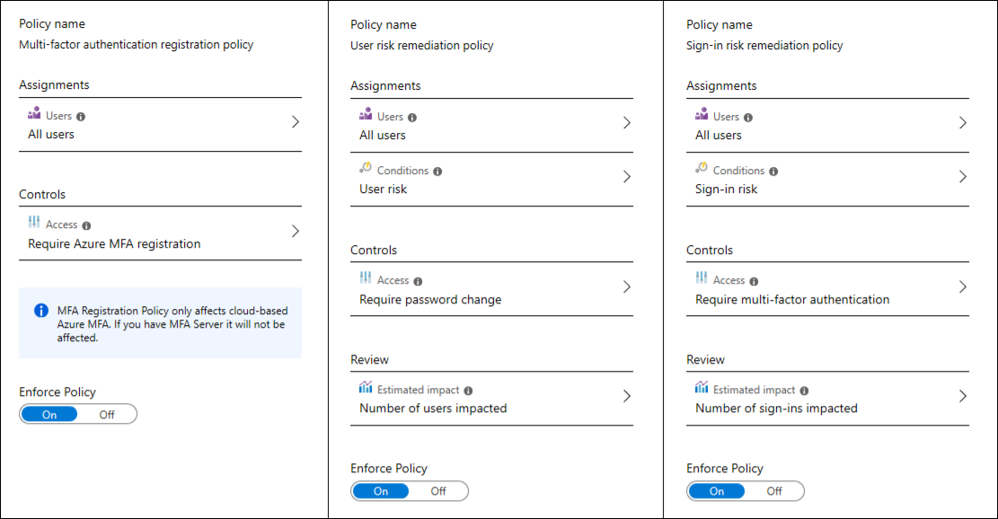
Azure AD Identity Protection Features
Automate the detection and remediation of identity-based risks
Investigate risks using data in the portal
Export risk detection data to third-party utilities for further analysis
Notes:
What is Azure Active Directory Identity Protection? - https://docs.microsoft.com/en-us/azure/active-directory/identity-protection/overview-identity-protection
Azure Active Directory Identity Protection includes three default policies that administrators can choose to enable. These policies include limited customization but are applicable to most organizations. All of the policies allow for excluding users such as your emergency access or break-glass administrator accounts.
Administrators can also choose to create a custom Conditional Access policy including sign-in risk as an assignment condition.

Slide 21
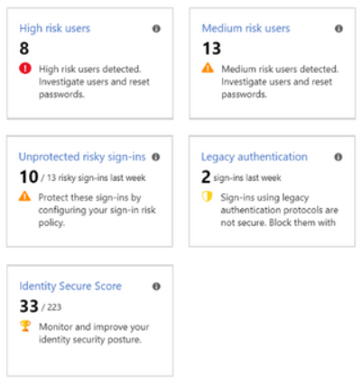
Azure Identity Protection Risk Events
Each detected suspicious action is stored in a record called a risk event
Leaked credentials
Sign in from anonymous IP addresses
Impossible travel to atypical locations
Sign in from unfamiliar locations
Sign in from infected devices
Sign in from IP addresses with suspicious activity
Notes:
Azure Active Directory risk detections - https://docs.microsoft.com/en-us/azure/active-directory/reports-monitoring/concept-risk-events
Note for slide delivery. The items are the left of the slide are a subset of the things detected by Identity Protection. Use those to highlight the breadth of what this capability does. If you need more details, or the class for more information, the notes below cover the entire set of current risks (as of Jan 5, 2021). There is another article below the list with more general information about Identity Protection.
Identity Protection identifies risks in the following classifications (Risk detection type – Description):
Anonymous IP address - Sign in from an anonymous IP address (for example: Tor browser, anonymizer VPNs).
Atypical travel - Sign in from an atypical location based on the user's recent sign-ins.
Malware linked IP address - Sign in from a malware linked IP address.
Unfamiliar sign-in properties - Sign in with properties we've not seen recently for the given user.
Leaked Credentials - Indicates that the user's valid credentials have been leaked.
Password spray - Indicates that multiple usernames are being attacked using common passwords in a unified, brute-force manner.
Azure AD threat intelligence - Microsoft's internal and external threat intelligence sources have identified a known attack pattern.
New country - This detection is discovered by Microsoft Cloud App Security (MCAS).
Activity from anonymous IP address - This detection is discovered by Microsoft Cloud App Security (MCAS).
Suspicious inbox forwarding - This detection is discovered by Microsoft Cloud App Security (MCAS).
What is Azure Active Directory Identity Protection? | Microsoft Docs

Slide 22
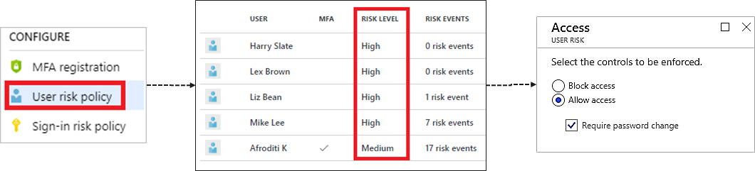
User Risk Policy
Applied to user sign-ins
Provide the condition (risk level) and action (block or allow)
Use a low threshold for greater security
Automatically respond based on a specific user’s risk level
Use a high threshold during policy roll out
Notes:
User risk policies - https://docs.microsoft.com/en-us/azure/active-directory/identity-protection/concept-identity-protection-policies#user-risk-policy
Identity Protection can calculate what it believes is normal for a user's behavior and use that to base decisions for their risk. User risk is a calculation of probability that an identity has been compromised. Administrators can make a decision based on this risk score signal to enforce organizational requirements. Administrators can choose to block access, allow access, or allow access but require a password change using Azure AD self-service password reset.

Slide 23
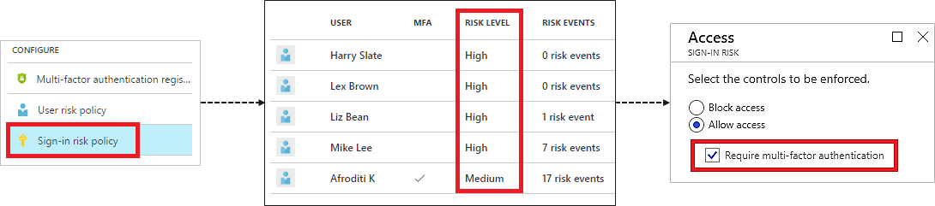
Sign-in Risk Policy
Applied to all browser traffic and sign-ins using modern authentication
Provide the condition (risk level) and action (block or allow)
Automatically respond to a specific risk level
Target all policies to specific users – omit certain types of users
Notes:
How To: Configure and enable risk policies - https://docs.microsoft.com/en-us/azure/active-directory/identity-protection/howto-identity-protection-configure-risk-policies
The sign-in risk policy detects suspicious actions that come along with the sign-in. It is focused on the sign-in activity itself and analyzes the probability that the sign-in may not have been performed by the user. The sign-in risk checks for things like whether a user has signed in from an unfamiliar location or unfamiliar IP address. You can then choose to require MFA for users based on the risk level of their sign-ins.
The user risk policy detects the probability that a user account has been compromised by detecting risk events that are atypical of a users behavior. Risk events require the recording of a user's activity over a length of time so that it's possible to detect abnormalities. You can then choose to block access to users based on their risk levels.
Risky sign-ins
The risky sign-ins report contains filterable data for up to the past 30 days (1 month).
With the information provided by the risky sign-ins report, administrators can find:
Which sign-ins are classified as at risk, confirmed compromised, confirmed safe, dismissed, or remediated.
Real-time and aggregate risk levels associated with sign-in attempts.
Detection types triggered
Conditional Access policies applied
MFA details
Device information
Application information
Location information
Administrators can then choose to take action on these events. Administrators can choose to:
Confirm sign-in compromise
Confirm sign-in safe

Slide 24
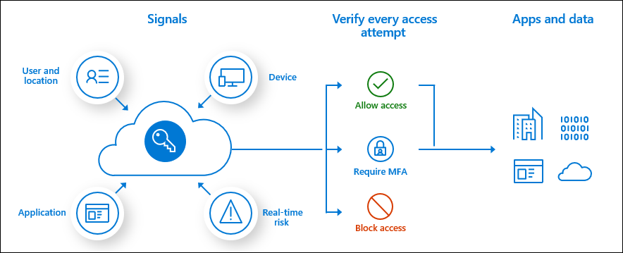
Azure AD Conditional Access
Identity management is the new control plane
Use signals to make an informed decision
Base the decision on organizational policy
Enforce the decision across resources
Notes:
What is Conditional Access? - https://docs.microsoft.com/en-us/azure/active-directory/conditional-access/overview

Slide 25
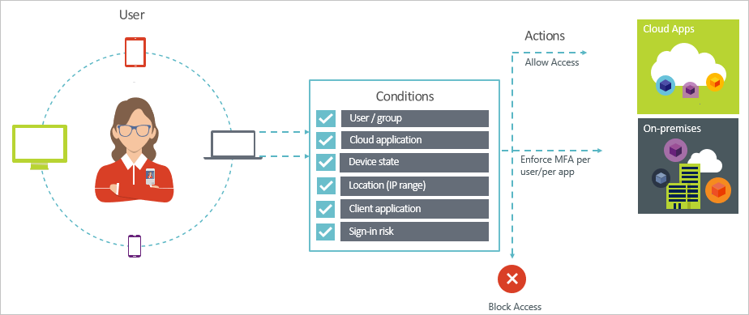
Conditions
Conditions – “When this happens”
Access controls – “Then do this”
Provides two step authentication verification
Lets you enforce controls on access to apps based on specific conditions
Notes:
Conditional Access: Require MFA for all users - https://docs.microsoft.com/en-us/azure/active-directory/conditional-access/howto-conditional-access-policy-all-users-mfa

Slide 26
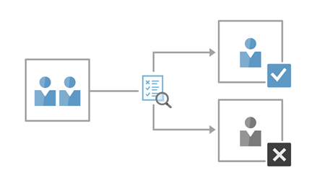
Access Reviews
Enable organizations to recertify group memberships, application access, and privileged role assignments
Evaluate guest user access
Evaluate employee access to applications and group membership
Track reviews for compliance or risk-sensitive applications
Evaluate the role assignment of administrative users (PIM)
membership
Premium P2 license – Global admins or User Admins membership
Notes:
What are Azure AD access reviews? - https://docs.microsoft.com/en-us/azure/active-directory/governance/access-reviews-overview
Why are Access Reviews important?
As new employees join,
•how do you ensure they have the right access to be productive?
As people move teams or leave the company,
•how do you ensure their old access is removed, especially when it involves guests?
Excessive access rights can lead to audit findings and compromises as they indicate a lack of control over access.
You must proactively engage with resource owners to ensure they regularly review who has access to their resources
.
Why to use Access Reviews?
•Too many users in privileged roles
•When automation is infeasible
•When a group is used for a new purpose
•Business critical data access
•Ask group owners to confirm they still need guests in their groups
•Have reviews recur periodically

Slide 27
Demonstrations: Azure AD Identity Protection
Create a conditional access policy requiring MFA
Create an access review
Notes:
In the virtual classroom consider having the students join you in doing the demonstrations. Or you could have someone share their screen and be coached through the demonstration. Consider which demonstrations to provide given your student’s interests and the labs they will be assigned.

Slide 28
Additional Study - Azure AD Identity Protection
Module Review Questions
Microsoft Learn Modules (docs.microsoft.com/Learn)
Overview of identity and access management in Microsoft 365
Protect your identities with Azure AD Identity Protection
Secure Azure Active Directory users with Multi-Factor Authentication (Exercise)
Notes:
For students who may be new to Azure or are struggling with the labs consider having them use their lab time going through the Learn modules instead.
(docs.microsoft.com/Learn)
Overview of identity and access management in Microsoft 365 - https://docs.microsoft.com/en-us/learn/modules/m365-identity-overview/
Secure Azure Active Directory users with Multi-Factor Authentication - https://docs.microsoft.com/en-us/learn/modules/secure-aad-users-with-mfa/
Protect your identities with Azure AD Identity Protection - https://docs.microsoft.com/en-us/learn/modules/protect-identities-with-aad-idp/

Slide 29
Enterprise Governance

Slide 30

Enterprise Governance
Shared Responsibility Model
Azure Cloud Security Advantages
Azure Hierarchy
Azure Policy
Azure Role Based Access Control (RBAC)
Azure RBAC vs Azure Policies
Built-in Roles
Resource Locks
Azure Blueprints
Azure Subscription Management
Notes:
Manage identity and access (30-35%)
Manage access control
Configure subscription and resource permissions
Configure resource group permissions
Configure custom RBAC roles
Identify the appropriate role
Apply principle of least privilege
Interpret permissions
Check access

Slide 31
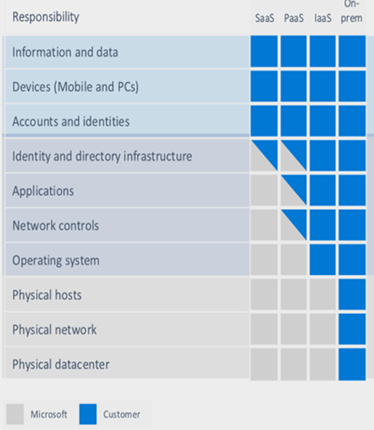
Shared Responsibility Model
Responsibility always retained by the customer
Responsibility varies by service type
Responsibility transfers to cloud provider
Notes:
Shared responsibility in the cloud - https://docs.microsoft.com/en-us/azure/security/fundamentals/shared-responsibility
This is critical for the customers to understand. There is a wide misconception that once a service is moved to the cloud the vendor will take full responsibility for it.
Organizations face many challenges with securing their datacenters, including recruiting and keeping security experts, using many security tools, and keeping pace with the volume and complexity of threats.
Microsoft Azure is uniquely positioned to help organizations with these challenges. Azure helps protect business assets while reducing security costs and complexity. Built-in security controls and intelligence help admins easily find and respond to threats and security gaps, so organizations can rapidly improve their security posture. By shifting responsibilities to Azure, organizations can get more security coverage—which allows them to move security resources and budget allocations to other business priorities.
The first thing to understand about cloud security is that different scopes of responsibility exist, depending on the kinds of services you use. For example, if you use virtual machines (VMs) in Azure, which provide Infrastructure as a Service (IaaS), Microsoft will be responsible for helping secure the physical network, physical storage, and virtualization platform, which includes updating the virtualization hosts. But you’ll need to take care of helping secure your virtual network and public endpoints and updating the guest operating system (OS) of your VMs. For all cloud deployment types, you own your data and identities. You are responsible for helping secure your data and identities, you're on-premises resources, and the cloud components you control (which vary by service type). Regardless of the deployment type, you always retain responsibility for the following:
Data
Endpoints
Accounts
Access management
It’s important to understand the division of responsibility between you and Microsoft in a Software as a Service (SaaS), Platform as a Service (PaaS), or IaaS deployment.

Slide 32
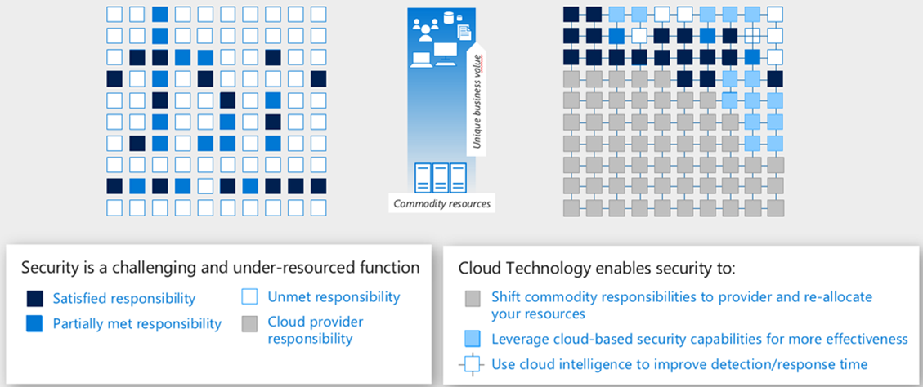
Azure Cloud Security Advantages
Traditional Approach
Cloud-Enabled Approach
Notes:
Security best practices for Azure solutions - https://azure.microsoft.com/mediahandler/files/resourcefiles/security-best-practices-for-azure-solutions/Azure%20Security%20Best%20Practices.pdf
The cloud offers significant advantages for solving long standing information security challenges. In an on-premises environment, organizations likely have unmet responsibilities and limited resources available to invest in security, which creates an environment where attackers are able to exploit vulnerabilities at all layers. The above diagram shows a traditional approach where many security responsibilities are unmet due to limited resources. In the cloud-enabled approach, you are able to shift day to day security responsibilities to your cloud provider and reallocate your resources.
In the cloud-enabled approach, you are also able to leverage cloud-based security capabilities for more effectiveness and use cloud intelligence to improve your threat detection and response time. By shifting responsibilities to the cloud provider, organizations can get more security coverage, which enables them to reallocate security resources and budget to other business priorities.

Slide 33
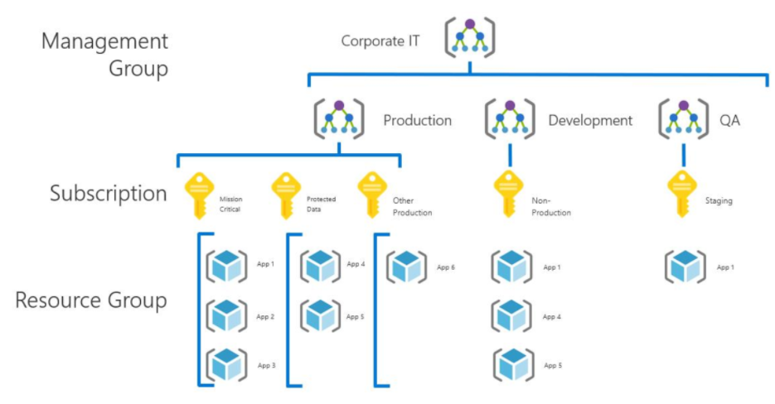
Azure Hierarchy
Management groups provides a level to manage multiple subscriptions
Subscriptions provision products and services for an account
Resource groups are containers for resources that share the same life cycle
Notes:
Modeling your organization - https://docs.microsoft.com/en-us/azure/cloud-adoption-framework/decision-guides/subscriptions/#modeling-your-organization
Management groups - https://docs.microsoft.com/en-us/azure/governance/management-groups/
The value of management groups
First: The capability of grouping your subscriptions into a logical group. This allows for the building of organization models or new structuring models that apply within your Azure environment.
Second: Another scenario where you would use management groups is to provide user access to multiple subscriptions. By moving multiple subscriptions under that management group, you can create one role-based access control (RBAC) assignment on the management group, which will inherit that access to all the subscriptions. One assignment on the management group can enable users to have access to everything they need instead of scripting RBAC over different subscriptions.

Slide 34
Azure Policy
Azure Policy is a service in Azure that you use to create, assign and, manage policies
Usage Cases
Allowed resource types - Specify the resource types that your organization can deploy.
Allowed virtual machine SKUs – Specify a set of virtual machine SKUs that your organization can deploy.
Allowed locations – Restrict the locations your organization can specify when deploying resources.
Require tag and its value - Enforces a required tag and its value.
Azure Backup should be enabled for Virtual Machines – Audit if Azure Backup service is enabled for all Virtual machines.
Azure Policy runs evaluations and scans for non-compliant resources
Advantages:
Enforcement and compliance
Apply policies at scale
Remediation
Notes:
Azure Policy Documentation - https://docs.microsoft.com/azure/azure-policy
There are three main pillars in the functionalities of Azure policy.
The first pillar is around real-time enforcement and compliance assessment. For example a policy would block the creation of resources that are located outside of US regions. Each policy also provides compliance assessment on all your existing resources to bring a state of compliance for each resource. The data then powers the compliance view so that one can see the aggregate result across all of the applied policies. Policies can be used to ensure that resource groups are getting tagged properly and automatically inheriting those tags from the resource group down to the resources.
The second pillar of policy is applying policies at scale by leveraging Management Groups**. By assigning policy to a management group one can impact hundreds of subscriptions and all of its reach resources through a single policy assignment. There also is the concept called policy initiative that allows you to group policies together so that you can see the aggregated compliance result. At the initiative level there's also a concept called exclusion where one can exclude either the child management group subscription resource group or resources from the policy assignment.
The third pillar of your policy is remediation by leveraging a remediation policy it will automatically remediate the non-compliant resource so that your environment always stays compliant. For existing resources they will be flagged as non-compliant but they won't automatically be changed because there can be impact to the environment. For these cases you can create a remediation task to bring these resources to compliance. Azure policy is a free service to use.

Slide 35


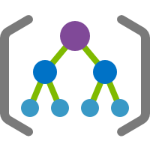






Azure Role-Based Access Control
Azure AD Admin roles and Azure RBAC roles work together to authenticate users.
Azure AD
Admin roles
Azure Active
Directory tenant
Global admin
Application admin
Application developer
Billing admin
…
Global admin/User access admin (elevated access)
Root
Azure RBAC
roles
Root management group
Owner
Contributor
Reader
User access admin
…
Management group
Subscription
Azure RBAC
roles
Resource group
Azure account
Owner
Contributor
Reader
User access admin
…
Resource
Notes:
Classic subscription administrator roles, Azure RBAC roles, and Azure AD administrator roles - https://docs.microsoft.com/en-us/azure/role-based-access-control/rbac-and-directory-admin-roles
The above diagram depicts how the classic subscription administrator roles, RBAC roles, and Azure AD administrator roles are related at a high level. Roles assigned at a higher scope, like an entire subscription, are inherited by child scopes, like service instances.
After you extend your on-premises Active Directory to the cloud by using Azure AD Connect, your employees can use and manage their Azure subscriptions by using their existing work identities. These Azure subscriptions automatically connect to Azure AD for SSO and access management. When you disable an on-premises Active Directory account, it automatically loses access to all Azure subscriptions connected with Azure AD. RBAC enables fine-grained access management for Azure. Using RBAC, you can grant just the amount of access that users need to perform their jobs. For example, you can use RBAC to let one employee manage virtual machines in a subscription while another manages SQL databases within the same subscription.
Each Azure subscription is associated with one Azure AD directory. Users, groups, and applications in that directory can manage resources in the Azure subscription. Grant access by assigning the appropriate RBAC role to users, groups, and applications at a certain scope. The scope of a role assignment can be a subscription, a resource group, or a single resource. A role assigned at a parent scope also grants access to the child scopes contained within it. For example, a user with access to a resource group can manage all the resources it contains, like websites, virtual machines, and subnets. The RBAC role that you assign dictates what resources the user, group, or application can manage within that scope. The scope of a role assignment can be a subscription, a resource group, or a single resource.
RBAC includes many built-in roles, which you can assign at different scopes, and allows you to create your own custom roles. To manage resources in Azure AD, such as users, groups, and domains, several Azure AD administrator roles exist.

Slide 36
Azure RBAC vs Azure Policies
Role Based Access Control (RBAC)
Azure Policy
Users
Role
Resource
Properties
Assigned
Configure
Evaluate
Corp
Standard
Effect
Condition
Report
Evaluate
Grant / Deny
Compliant?
Azure RBAC manages who has access to Azure resources, what areas they have access to and what they can do with those resources.
Azure Policies focus on resource properties during deployment and for already existing resources.
Notes:
Azure Policy and RBAC - https://docs.microsoft.com/en-us/azure/governance/policy/overview#azure-policy-and-rbac
The GOAL of this slide – Azure RBAC and Azure Policy working together makes for a more secure system. Either one alone of focuses on part of the security picture.
Slide RBAC box presentation – Users in your Azure AD are assigned built-in or custom roles that can perform certain tasks. Those roles have specific conditions like MFA or a specific device that are evaluated to see if the user can perform the task. If the user meets the condition, they are granted access to the operation.
Slide Policy box presentation – Resources in your Azure subscription have properties. There are rules (stored in the policy) that define what the corporate standard is for that resource (All VMs have to have a firewall running as example). Those properties are evaluated against the policy definition, and if they match the resource is reported as compliant.
There are a few key differences between Azure Policy and role-based access control (RBAC). Azure Policy evaluates state by examining properties on resources which are represented in Resource Manager and properties of some Resource Providers. Azure Policy doesn't restrict actions (also called operations). Azure Policy ensures that resource state is compliant to your business rules without concern for who made the change or who has permission to make a change.
RBAC focuses on managing user actions at different scopes. If control of an action is required, then RBAC is the correct tool to use. Even if an individual has access to perform an action, if the result is a non-compliant resource, Azure Policy still blocks the create or update.
The combination of RBAC and Azure Policy provide full scope control in Azure.

Slide 37
Built-in Roles for Azure Resources
Built-in Role | Description
Owner | Allows you to manage everything including access to resources
Contributor | Allows you to manage everything except managing access to resources
Reader | Allows you to view everything but not make any changes
User Access Administrator | Allows you to manage user access to Azure resources
Notes:
Azure built-in roles - https://docs.microsoft.com/en-us/azure/role-based-access-control/built-in-roles
Describe Azure AD roles. Explain how roles are used and how you create roles.
Azure role-based access control (RBAC) has several Azure built-in roles that you can assign to users, groups, service principals, and managed identities. Role assignments are the way you control access to Azure resources. If the built-in roles don't meet the specific needs of your organization, you can create your own Azure custom roles.

Slide 38
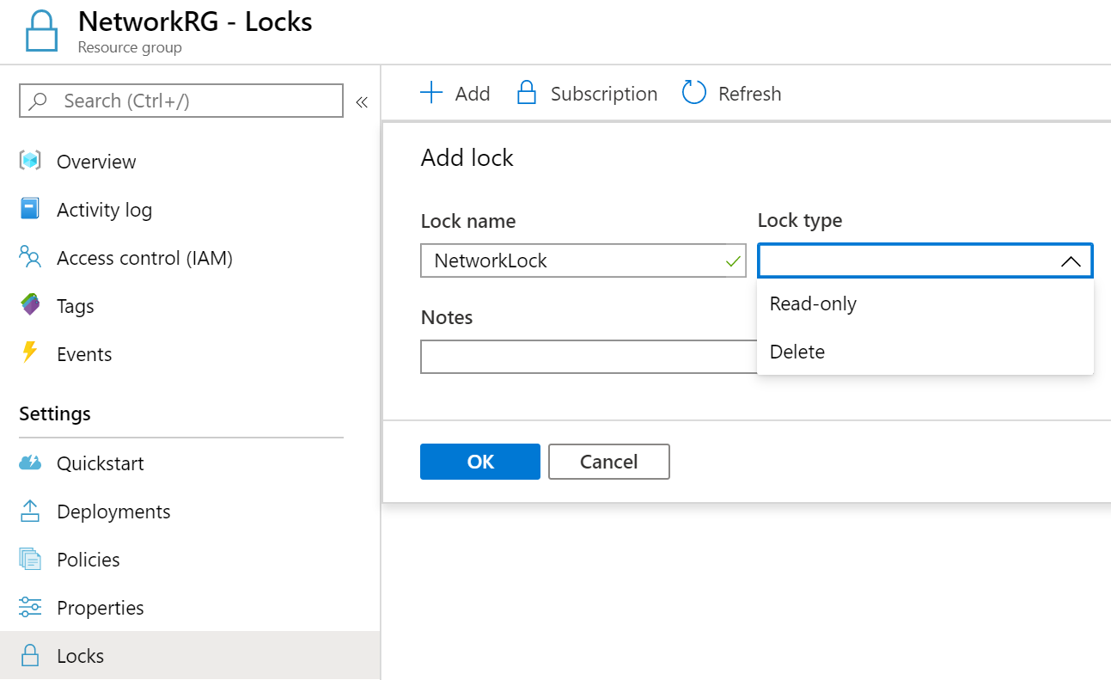
Resource Locks
Associate the lock with a subscription, resource group, or resource
Locks are inherited by child resources
Read-Only locks prevent any changes to the resource
Delete locks prevent deletion
Notes:
Lock resources to prevent unexpected change - https://docs.microsoft.com/en-us/azure/azure-resource-manager/resource-group-lock-resources
As an administrator, you may need to lock a subscription, resource group, or resource to prevent other users in your organization from accidentally deleting or modifying critical resources. You can set the lock level to CanNotDelete or ReadOnly. In the portal, the locks are called Delete and Read-only respectively.
CanNotDelete means authorized users can still read and modify a resource, but they can't delete the resource.
ReadOnly means authorized users can read a resource, but they can't delete or update the resource. Applying this lock is similar to restricting all authorized users to the permissions granted by the Reader role.
✔ Only Owner and User Access Administrator roles can create or delete management locks.

Slide 39
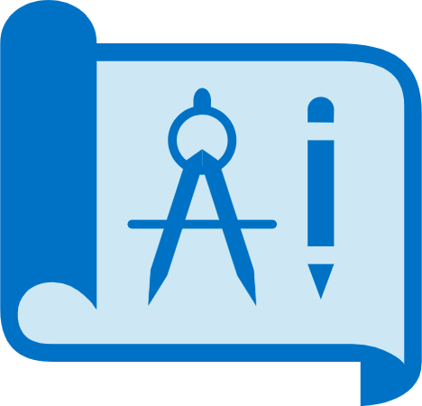
Azure Blueprints (preview)
Designed to help with environment setup
Create reusable environment definitions that can recreate your Azure resources and apply your policies instantly
A package or container for composing focus-specific sets of standards, patterns, and requirements
Notes:
What is Azure Blueprints - https://docs.microsoft.com/en-us/azure/governance/blueprints/overview
Instructor Note → Azure Blueprints are a Preview feature at this point.
Just as a blueprint allows an engineer or an architect to sketch a project's design parameters, Azure Blueprints enables cloud architects and central information technology groups to define a repeatable set of Azure resources that implements and adheres to an organization's standards, patterns, and requirements. Azure Blueprints makes it possible for development teams to rapidly build and stand up new environments with trust they're building within organizational compliance with a set of built-in components -- such as networking -- to speed up development and delivery.
Blueprints are a declarative way to orchestrate the deployment of various resource templates and other artifacts such as:
Role Assignments
Policy Assignments
Azure Resource Manager templates
Resource Groups
The Azure Blueprints service is backed by the globally distributed Azure Cosmos DB. Blueprint objects are replicated to multiple Azure regions. This replication provides low latency, high availability, and consistent access to your blueprint objects, regardless of which region Blueprints deploys your resources to.

Slide 40
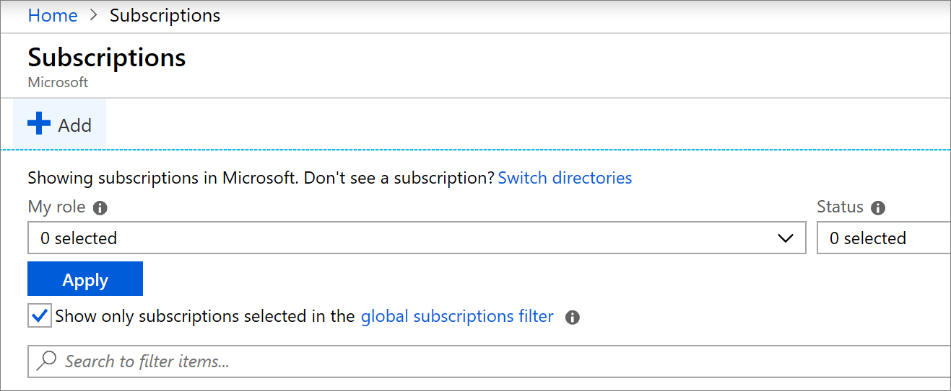
Azure Subscription Management
The Account Owner role can create Azure subscriptions.
Organizations assign Azure subscriptions to various business units.
If you're an Enterprise Agreement(EA) customer, your enterprise administrators can transfer billing ownership of your subscriptions between accounts.
Notes:
Transfer billing ownership of an Azure subscription to another account - https://docs.microsoft.com/en-us/azure/cost-management-billing/manage/billing-subscription-transfer
Describe the scenario and the process for Azure subscription transfer. An Azure Active Directory (AD) tenant is created for you when you sign up for Azure. The tenant represents your account. You use the tenant to manage access to your subscriptions and resources.
When you create a new subscription, it's hosted in your account's Azure AD tenant. If you want to give others access to your subscription or its resources, you need to invite them to join your tenant. Doing so helps you control access to your subscriptions and resources. You can create additional subscriptions for your account in Azure. You might want an additional subscription to avoid reaching subscription limits, to create separate environments for billing and security, or to isolate data for compliance reasons.
If you want to create Azure subscriptions under your organization's Enterprise Agreement (EA), you need to have the Account Owner role for your organization.
If you need to transfer billing ownership of your Azure subscription if you're leaving your organization, or you want your subscription to be billed to another account. Transferring billing ownership to another account provides the administrators in the new account permission for billing tasks. They can change the payment method, view charges, and cancel the subscription.
An Azure Active Directory (AD) tenant is created for you when you sign up for Azure. The tenant represents your account. You use the tenant to manage access to your subscriptions and resources.
- Point out that Billing Administrators and Global Administrators can transfer a Subscription to another AAD tenant.

Slide 41
Demonstrations: Enterprise Governance
Azure RBAC roles
Manage resource locks
Notes:
In the virtual classroom consider having the students join you in doing the demonstrations. Or you could have someone share their screen and be coached through the demonstration. Consider which demonstrations to provide given your student’s interests and the labs they will be assigned.

Slide 42
Additional Study - Enterprise Governance
Module Review Questions
Microsoft Learn Modules (docs.microsoft.com/Learn)
Control and organize Azure resources with Azure Resource Manager
Secure your Azure resources with role-based access control (Exercise)
Create custom roles for Azure resources with role-based access control (Exercise)
Apply and monitor infrastructure standards with Azure Policy
Manage access to an Azure subscription by using Azure role-based access control (Exercise)
Control and organize Azure resources with Azure Resource Manager
Notes:
For students who may be new to Azure or are struggling with the labs consider having them use their lab time going through the Learn modules. Instead.
(docs.microsoft.com/Learn)
Control and organize Azure resources with Azure Resource Manager - https://docs.microsoft.com/en-us/learn/modules/control-and-organize-with-azure-resource-manager/
Secure your Azure resources with role-based access control (RBAC) - https://docs.microsoft.com/en-us/learn/modules/secure-azure-resources-with-rbac/
Create custom roles for Azure resources with role-based access control (RBAC) - https://docs.microsoft.com/en-us/learn/modules/create-custom-azure-roles-with-rbac/
Apply and monitor infrastructure standards with Azure Policy - https://docs.microsoft.com/en-us/learn/modules/intro-to-governance/
Manage access to an Azure subscription by using Azure role-based access control (RBAC) - https://docs.microsoft.com/en-us/learn/modules/manage-subscription-access-azure-rbac/
Control and organize Azure resources with Azure Resource Manager - https://docs.microsoft.com/en-us/learn/modules/control-and-organize-with-azure-resource-manager/

Slide 43
Privileged Identity Management
Notes:
The most important piece of privileged identity management (PIM) is not identity or management: it is privileged..
This is because the heart of a robust and functional PIM system is determining who should — and just as importantly, who should not — have
administrative access to critical systems, since access often users the ability to access secure data, change configurations, install software, modify
accounts, and so on.
In the Forrester Wave™: Privileged Identity Management, Report, Forrester estimates that 80% of data breaches can be traced back to compromised privileged credentials such as passwords, tokens, keys and certificates. Indeed, it is alarming how simple it is for cyber criminals to grab Windows administrator and Unix root credentials, and then move laterally across systems and devices..
4 Reasons PIM Is Crucial
As highlighted by Forrester in the above report, there are four key reasons why PIM must be a crucial part of an organization’s security profile — including SMBs, which are increasingly becoming ground zero for cyber crime. These four reasons are:
1. PIM helps thwart would-be hackers from getting a foothold into networks and launching full-scale attacks — including some that persist for prolonged periods of time. A study by IBM found that the average time to detect a data breach is 197 days, and it takes an additional 69 days to contain it and clean it up.
2. PIM governs and safeguards the interaction between customer identity and access management (CIAM) portals and customer relationship management (CRM) systems. For years, hackers have been targeting vulnerabilities in this integration to snoop and steal privileged credentials.
3. PIM helps keep hackers from gaining access to privileged database credentials, which can be catastrophic. Just ask Equifax, which in 2017 was the victim of a mega-hack that exposed the confidential information of more than 150 million clients worldwide. The situation was so chaotic that according to a recently-released report from the U.S. Government’s Accountability Office (GAO), Equifax’s IT staff spent weeks re-running the hacker’s own database queries just to find out what was stolen!
4. PIM secures and protects containerized and cloud environments, which require administrator keys to function and share information. To that end, products such as Azure AD support custom role assignments for various tasks.

Slide 44

Privileged Identity Management (PIM)
Microsoft's Zero Trust Model
Microsoft Identity Management Evolution
PIM Features
PIM Scope
PIM Onboarding
PIM Configuration Settings
PIM Workflow
Notes:
Manage identity and access (30-35%)
Configure secure access by using Azure AD
Monitor privileged access for Azure AD Privileged Identity Management (PIM)
Configure Access Reviews
Activate and configure PIM

Slide 45
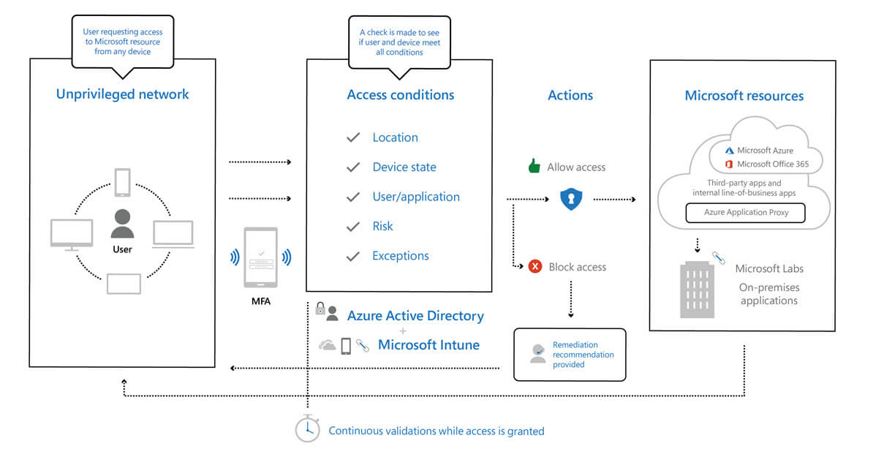
Microsoft’s Zero Trust Model
Assume breach and verify each request as though it originates from an open network
Notes:
Zero Trust Model - https://www.microsoft.com/en-us/security/business/zero-trust
Gone are the days when security was focused on a strong perimeter defense to keep attackers out. Outside your perimeter was treated as hostile, inside the wall an organizations systems were trusted. Today's security posture is to “assume breach” and or “zero trust model”. The perimeter defense is no longer the focus of security professionals. Modern organizations have to support access to data and services as evenly as from inside the corporate firewall and outside it.
The Zero Trust Model (ZTM) was introduced by analyst firm Forrester Research. ZTM states to never assume trust but instead to continually validate trust. When users, devices, and data all resided inside the organizations firewall, they were assumed to be trusted. This assumed trust allows for easy lateral movement once an endpoint device was compromised by a bad actor. The Zero Trust Model relies on verifiable user and device trust claims to grant access to organization resources. No longer is trust assumed based on the location inside an organization's perimeter. With most users now accessing apps and data from the internet, most transaction components are no longer under organizational control.
Trust determination components include:
Identity provider
Device directory
Policy evaluation service
Access proxy

Slide 46
Microsoft Identity Management Evolution
We recommend Azure AD Privileged Identity Management as the service to help
protect your privileged accounts
Traditional
Advanced
Optimal
On-premises identity provider is in use
No SSO is present between cloud and on-premises apps
Visibility into identity risk is very limited
Cloud identity federates with on-premises system
Conditional access policies gate access and provide remediation actions
Analytics improve visibility
Password less authentication is enabled
User, device, location and behavior is analyzed in real time to determine risk and deliver ongoing protection
MFA is enforced
Notes:
Identity and access management - https://docs.microsoft.com/en-us/azure/architecture/framework/security/identity

Slide 47


Azure AD Privileged Identity Management (PIM)
Time-based and approval-based role activation for privileged users
Just-in-time privileged access to Azure
Justification to understand why users activate
Time-bound access to resources
Notifications when privileged roles are activated
Approval to activate privileged roles
Access reviews to ensure users still need roles
Multi-factor authentication to activate any role
Audit history for internal or external audit
Notes:
What is Azure AD Privileged Identity Management? - https://docs.microsoft.com/en-us/azure/active-directory/privileged-identity-management/pim-configure
Organizations want to minimize the number of people who have access to secure information or resources. This reduces the chance of a malicious actor getting that access, or an authorized user inadvertently impacting a sensitive resource. However, users still need to carry out privileged operations in Azure AD, Azure, Office 365, or SaaS apps. With PIM, organizations can give users just-in-time (JIT) privileged access to Azure resources and Azure AD.
Privileged Identity Management provides time-based and approval-based role activation to mitigate the risks of excessive, unnecessary, or misused access permissions on resources that you care about. PIM lets you manage risks, address compliance and governance, and reduce costs.

Slide 48
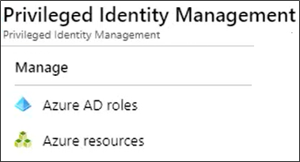
PIM Scope
Azure AD Roles
Assign users to a role – users must elevate to use the privileges granted by the role
Prioritize protecting Azure AD roles that have the greatest number of permissions
Azure resources
Identify the management groups and subscriptions
Resources most vital for your organization or host the most sensitive data
Resources that core, customer-facing applications depend on - PIM will help you discover these resources
Which Azure AD roles and resources should be protected with PIM?
Notes:
Roles that can be managed by Privileged Identity Management - https://docs.microsoft.com/en-us/azure/active-directory/privileged-identity-management/pim-deployment-plan#roles-that-can-be-managed-by-privileged-identity-management
Ensure access to privileged accounts complies with the principle of least privilege principle (POLP), which gives end users only as much access as required to perform their jobs — and nothing more.

Slide 49
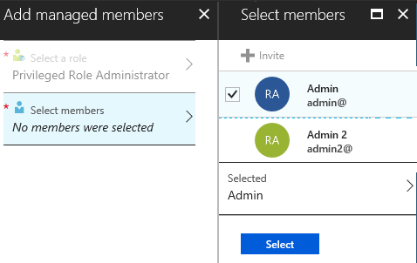
PIM Onboarding
PIM automatically enable when a privileged role goes into PIM or Roles and Administrators
The Global administrator (first user) who enables PIM gets write access
The first user can assign others to the Privileged Role Administrator
Global administrators (not first user), Security administrators, and Security readers have read-only access
Ensure there are always at least two Privileged Role Administrators
Notes:
License requirements to use Privileged Identity Management - https://docs.microsoft.com/en-us/azure/active-directory/privileged-identity-management/subscription-requirements
Grant access to other administrators to manage Privileged Identity Management - https://docs.microsoft.com/en-us/azure/active-directory/privileged-identity-management/pim-how-to-give-access-to-pim
First PIM user is also assigned Security Administrator and Privileged Role Administrator roles
Global Administrator requires elevated access - assigns others to the Privileged Role Administrator
When a user who is active in a privileged role in an Azure AD organization with a Premium P2 license goes to Roles and administrators in Azure AD and selects a role (or even just visits Privileged Identity Management):
Azure automatically enables PIM for the organization
Their experience is now that they can either assign a "regular" role assignment or an eligible role assignment
When PIM is enabled it doesn't have any other effect on your organization that you need to worry about. It gives you additional assignment options such as active vs eligible with start and end time. PIM also enables you to define scope for role assignments using Administrative Units and custom roles. If you are a Global Administrator or Privileged Role Administrator, you might start getting a few additional emails like the PIM weekly digest. You might also see MS-PIM service principal in the audit log related to role assignment. This is an expected change that should have no effect on your workflow.
Licensing → Azure AD Premium P2, Enterprise Mobility + Security (EMS) E5, or Microsoft 365 M5 license (subject to change)

Slide 50
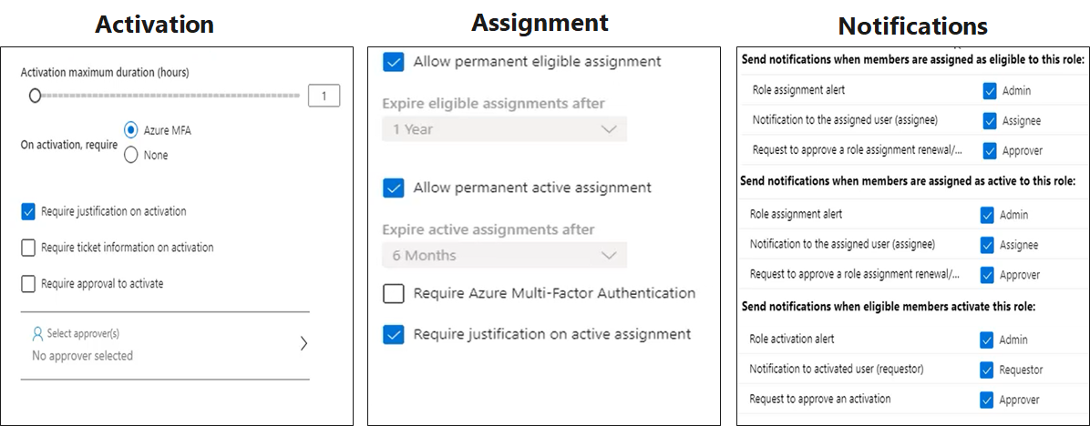
PIM Configuration Settings
Settings can be different for Azure AD roles and Azure resources
Notes:
Configure Azure AD role settings in Privileged Identity Management - https://docs.microsoft.com/en-us/azure/active-directory/privileged-identity-management/pim-how-to-change-default-settings

Slide 51
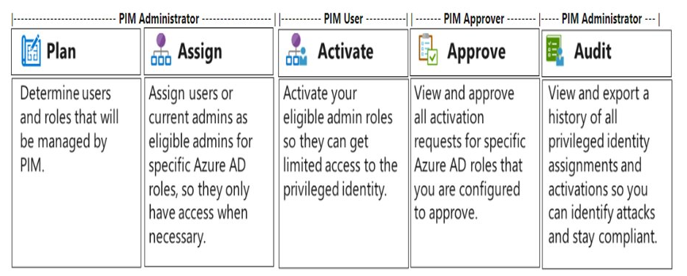
PIM Workflow
Notes:
Gartner and Centrify have teamed up to highlight best practices for establishing a comprehensive PIM system. These include:
Identify and analyze all privileged accounts and end users to ensure that access is appropriate, aligns with acceptable risk levels, and complies with regulatory requirements.
Ensure access to privileged accounts complies with the principle of least privilege principle (POLP), which gives end users only as much access as required to perform their jobs — and nothing more.
Constantly monitor all privileged account usage and enforce strict controls for sharing credentials.
Implement high-trust authentication methods for privileged access and leverage suitable PIM/PAM tools and technologies.
Augment and extend privileged identity management with access governance controls to meet ongoing compliance needs (e.g. requiring account owners to certify that they still require privileged access after a period of time).

Slide 52
Demonstration: PIM Resources
Azure AD PIM for roles
Azure AD PIM for resources
Notes:
In the virtual classroom consider having the students join you in doing the demonstrations. Or you could have someone share their screen and be coached through the demonstration. Consider which demonstrations to provide given your student’s interests and the labs they will be assigned.

Slide 53
Additional Study - Privileged Identity Management
Module Review Questions
Microsoft Learn Modules (docs.microsoft.com/Learn)
Protect identity and access with Microsoft 365
Getting Started with Microsoft Identity (Exercise)
Notes:
For students who may be new to Azure or are struggling with the labs consider having them use their lab time going through the Learn modules instead.
There are currently no Learn modules on PIM - (docs.microsoft.com/Learn)
Protect identity and access with Microsoft 365 - https://docs.microsoft.com/en-us/learn/paths/m365-identity/
PIM Documentation - https://docs.microsoft.com/en-us/azure/active-directory/privileged-identity-management/

Slide 54
Hybrid Identity

Slide 55

Hybrid Identity
Azure AD Connect
Azure AD Connect cloud sync
Authentication Options
Password Hash Synchronization (PHS)
Pass-through Authentication (PTA)
Federation with Azure AD
Password Writeback
Authentication Decision Tree
Notes:
Manage identity and access (30-35%)
Manage Azure Active Directory identities
Configure password writeback
Configure authentication methods including password hash and Pass Through Authentication (PTA), OAuth, and passwordless (not ADFS)

Slide 56
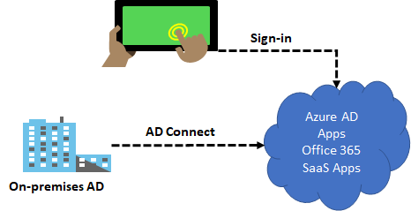
Azure AD Connect
Integrate your on-premises directories with Azure Active Directory
Provides a common identity for your users for Office 365, Azure, and SaaS applications integrated with Azure AD
There are several authentication options to enable hybrid identity
Notes:
What is Azure AD Connect - https://docs.microsoft.com/en-us/azure/active-directory/hybrid/whatis-azure-ad-connect
SaaS = Software as a Service
Azure AD Connect will integrate your on-premises directories with Azure Active Directory. This allows you to provide a common identity for your users for Office 365, Azure, and SaaS applications integrated with Azure AD in a hybrid identity environment. Microsoft Azure Active Directory Connect can be downloaded for free. Integrating your on-premises directories with Azure AD makes your users more productive by providing a common identity for accessing both cloud and on-premises resources.

Slide 57
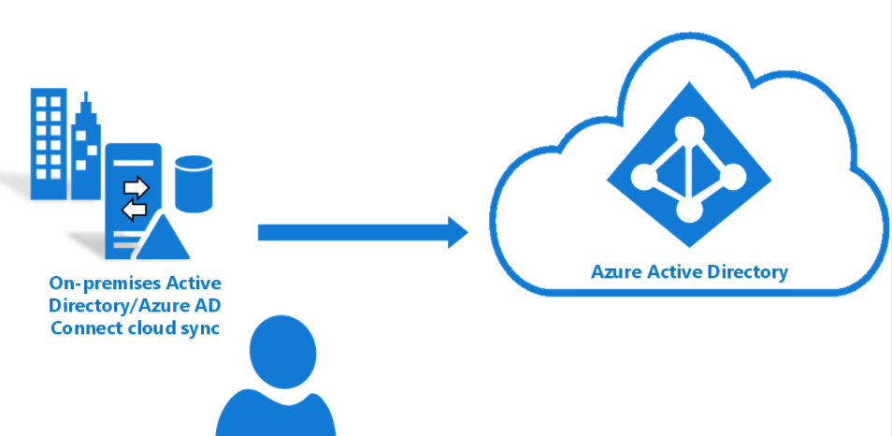
Azure AD Connect cloud sync
Alternate method to integrate your on-premises directories with Azure Active Directory
Uses the Azure AD cloud provisioning agent
Runs stand-alone or along-side Azure AD Connect
Notes:
All you need to know about Cloud Sync → Azure AD Connect cloud sync documentation | Microsoft Docs
How is Azure AD Connect cloud sync different from Azure AD Connect sync?
With Azure AD Connect cloud sync, provisioning from AD to Azure AD is orchestrated in Microsoft Online Services. An organization only needs to deploy, in their on-premises and IaaS-hosted environment, a lightweight agent that acts as a bridge between Azure AD and AD. The provisioning configuration is stored in Azure AD and managed as part of the service.
What is Azure AD Connect cloud sync
Azure AD Connect cloud sync is new offering from Microsoft designed to meet and accomplish your hybrid identity goals for synchronization of users, groups and contacts to Azure AD. It accomplishes this by using the Azure AD cloud provisioning agent instead of the Azure AD Connect application. However, it can be used alongside Azure AD Connect sync and it provides the following benefits:
Support for synchronizing to an Azure AD tenant from a multi-forest disconnected Active Directory forest environment: The common scenarios include merger & acquisition, where the acquired company's AD forests are isolated from the parent company's AD forests and companies that have historically had multiple AD forests.
Simplified installation with light-weight provisioning agents: The agents act as a bridge from AD to Azure AD, with all the sync configuration managed in the cloud.
Multiple provisioning agents can be used to simplify high availability deployments, particularly critical for organizations relying upon password hash synchronization from AD to Azure AD.
Support for large groups with up to 50K members. It is recommended to use only the OU scoping filter when synchronizing large groups.

Slide 58
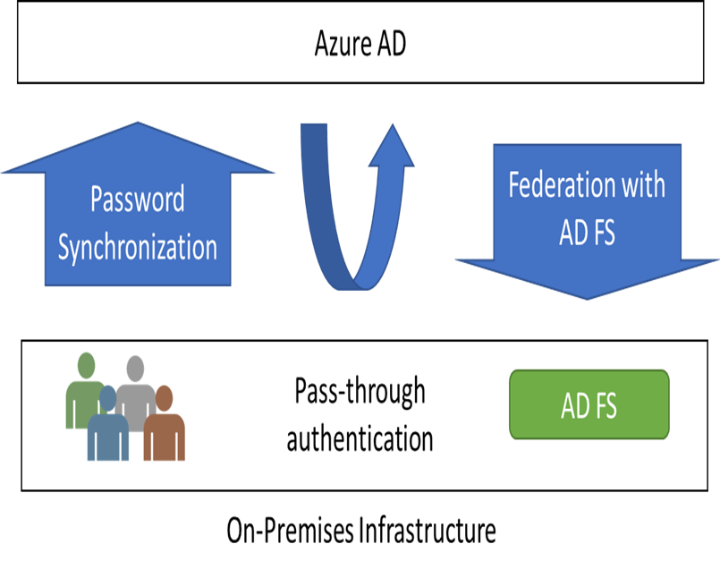
Authentication Options
Password Hash Synchronization (PHS) can synchronize an encrypted version of the password hash for user accounts
Pass-through authentication (PTA) authenticates the username and password with the on-premises domain controllers
AD FS is the Microsoft implementation of an identity federation solution that uses claims-based authentication
Notes:
What is Azure AD Connect - https://docs.microsoft.com/en-us/azure/active-directory/hybrid/whatis-azure-ad-connect
Each of these options is discussed in more detail on the following slides.

Slide 59
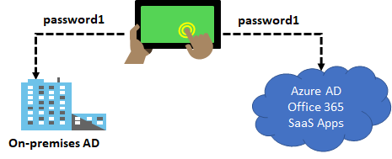
Password Hash Synchronization
Password hash synchronizes user passwords from on-premises Active Directory to cloud-based Azure AD
Sign into Azure AD services using the on-premises password
Improve the productivity of your users and reduce your helpdesk costs
Notes:
What is password hash synchronization with Azure AD? - https://docs.microsoft.com/en-us/azure/active-directory/hybrid/whatis-phs
Password hash synchronizes user passwords from on-premises Active Directory to cloud-based Azure AD. Sign in to Azure AD services using the on-premises password. Improve the productivity of your users and reduce your helpdesk costs.
How password hash synchronization works
https://docs.microsoft.com/en-us/azure/active-directory/hybrid/how-to-connect-password-hash-synchronization#how-password-hash-synchronization-works
✔️ This is same sign-in, not single sign-on. The user still authenticates against two separate directory services.

Slide 60
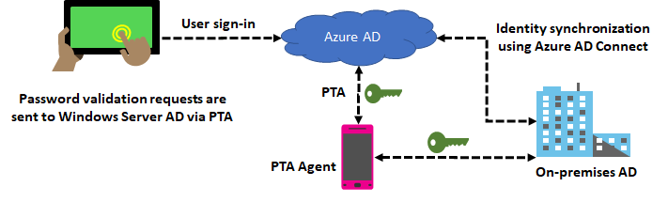
Pass-through Authentication
Supports user sign-in into all web browser-based applications and into Microsoft Office client applications
Is a free feature and can be enabled via Azure AD Connect
Is not only for user sign-in but allows an organization to use other Azure AD features – MFA and Self-Service Password Reset
Notes:
User sign-in with Azure Active Directory Pass-through Authentication - https://docs.microsoft.com/en-us/azure/active-directory/hybrid/how-to-connect-pta
Azure Active Directory (Azure AD) Pass-through Authentication allows your users to sign in to both on-premises and cloud-based applications using the same passwords. This feature provides your users a better experience - one less password to remember, and reduces IT helpdesk costs because your users are less likely to forget how to sign in. When users sign in using Azure AD, this feature validates users' passwords directly against your on-premises Active Directory.

Slide 61
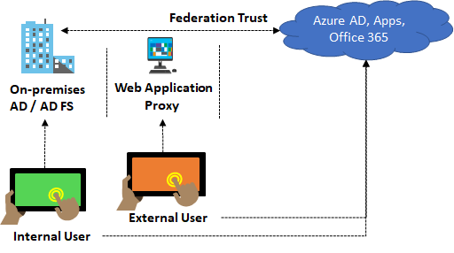
Federation with Azure AD
Federation is a collection of domains that have established trust
You can federate your on-premises environment with Azure AD and use this federation for authentication and authorization
This sign-in method ensures that all user authentication occurs on-premises
Notes:
Azure AD Connect and federation - https://docs.microsoft.com/en-us/azure/active-directory/hybrid/how-to-connect-fed-whatis

Slide 62
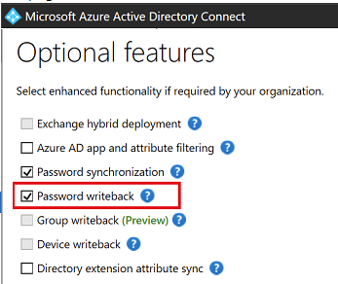
Password Writeback
Use Password Writeback to configure Azure AD to write passwords back to your on-premises Active Directory
A component of Azure AD Connect
Available to subscribers of Premium Azure Active Directory editions
Removes the need to set up and manage an on-premises SSPR solution
Notes:
Tutorial: Enable Azure Active Directory self-service password reset writeback to an on-premises environment - https://docs.microsoft.com/en-us/azure/active-directory/authentication/tutorial-enable-sspr-writeback
Having a cloud-based password reset utility is great but most companies still have an on-premises directory where their users exist. How does Microsoft support keeping traditional on-premises Active Directory (AD) in sync with password changes in the cloud? Password writeback is a feature enabled with Azure AD Connect that allows password changes in the cloud to be written back to an existing on-premises directory in real time.
Password writeback provides:
Enforcement of on-premises Active Directory password policies. When a user resets their password, it is checked to ensure it meets your on-premises Active Directory policy before committing it to that directory. This review includes checking the history, complexity, age, password filters, and any other password restrictions that you have defined in local Active Directory.
Zero-delay feedback. Password writeback is a synchronous operation. Your users are notified immediately if their password did not meet the policy or could not be reset or changed for any reason.
Supports password changes from the access panel and Office 365. When federated or password hash synchronized users come to change their expired or non-expired passwords, those passwords are written back to your local Active Directory environment.
Supports password writeback when an admin resets them from the Azure portal. Whenever an admin resets a user’s password in the Azure portal, if that user is federated or password hash synchronized, the password is written back to on-premises. This functionality is currently not supported in the Office admin portal.
Doesn’t require any inbound firewall rules. Password writeback uses an Azure Service Bus relay as an underlying communication channel. All communication is outbound over port 443.

Slide 63
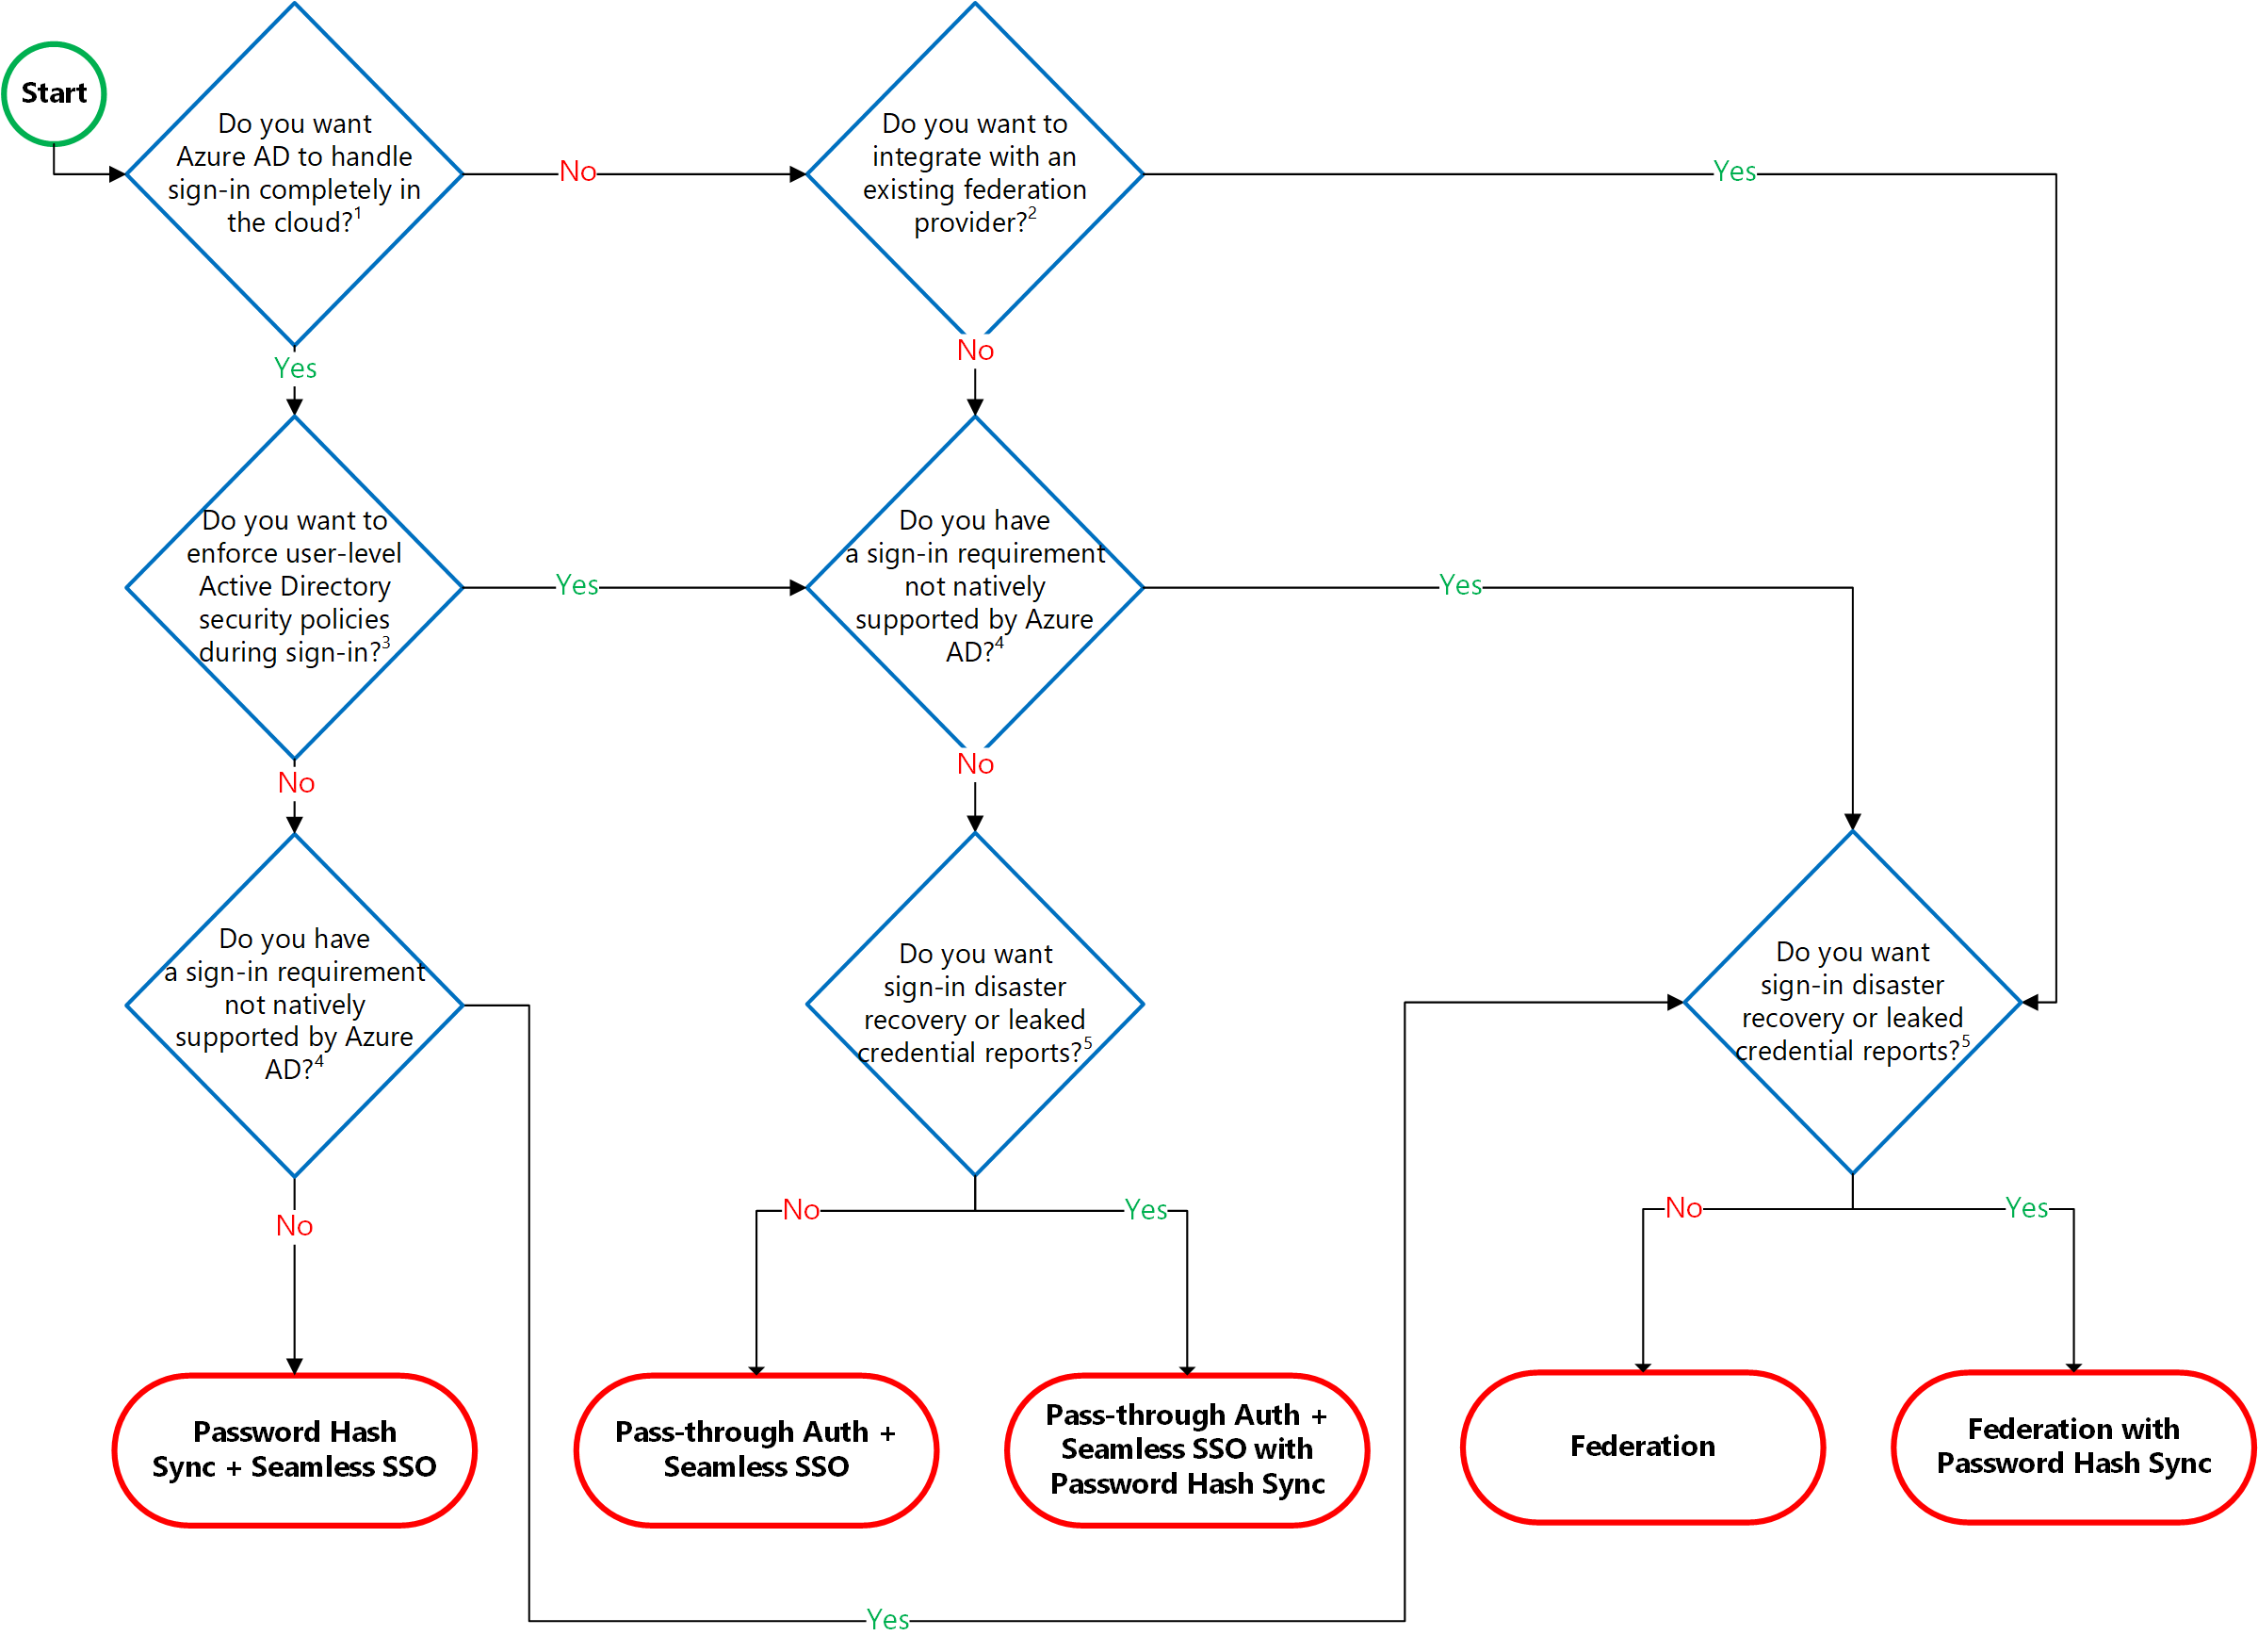
Authentication Decision Tree
Notes:
https://github.com/Azure/fta-identity/blob/master/identity-applications/aad-external-identities-decision-tree.md
Azure Active Directory External Identities Decision Tree
There are a number of flavors of Azure Active Directory (Azure AD) that allow you to work with "external identities", i.e. users that are outside of your own organization:
Azure AD (sometimes also referred to as Azure AD B2E - Business to Enterprise) When writing applications for Azure AD, you can target users from a single organization (single tenant), or users from any organization that already has an Azure AD tenant (called multi-tenant applications).
Azure AD B2B (Business to Business) This isn't so much a different directory service, it's an extension on top of Azure AD that allows you to work with external identities, mainly for collaboration scenarios using Microsoft applications (e.g. Office 365, Microsoft Teams, PowerBI, ...). In Azure AD B2B, you invite external users into your own tenant as "guest" users that you can then assign permissions to (for authorization) while still allowing them to keep using their existing credentials (for authentication) inside their own organization.
Azure AD B2C (Business to Consumer, Customer or even Citizen) This is a separate directory service (but still built on top of the global Azure AD infrastructure) which enables you to customize and control how customers sign up, sign in, and manage their profiles when using your applications.
In order to choose the right Azure AD flavor for your project, there are a number of decision factors that come into play. This lesson provides a decision tree and guidance to help you make the right choice.
Here are some additional considerations for a few of these decision points:
Should any user from any and all existing Azure AD tenants be able to sign in? covers the scenario where all three of the following conditions are met: The users will be defined in a regular Azure AD tenant (not in Azure AD B2C) or have a personal Microsoft Account. The Azure AD tenants that contain the users already exist. You accept users to sign in from any existing Azure AD tenant (in practice you can of course still reject users inside the application itself depending on the tenant that they signed in through, e.g. if you only want to allow users from specifically allowed tenants).
Do you prefer to 'see' the users in your own Azure AD tenant (as guests)? This is an important decision factor to check if Azure AD B2B is suitable for your scenario because B2B users are represented as guest users inside your own Azure AD tenant. This has implications around trust and security, e.g. guest users can be browsed in your directory and granted permissions to your resources (e.g. SharePoint documents, Outlook calendars, PowerBI dashboards, even your Azure subscriptions). Guest users are also able to get information about users in your directory (which they are now a guest of), and depending on the permissions you've granted these guest users they can also browse users and groups, see application definitions and more. This may be exactly what you want in a situation where you trust these users to collaborate with your organization (e.g. business partners or vendors); it may also be something you explicitly want to avoid (e.g. to prevent someone from inadvertently or maliciously granting these guest users permissions to corporate resources or your Azure subscriptions). Think of it this way: would you invite these users into your physical office building? If so, then B2B guest user access may be a great choice.
Do you need extensive support for branding/customization? Azure AD (and by extension, Azure AD B2B) allow for branding of the sign-in page, but this is more limited than what Azure AD B2C offers. For now, fully customized user experiences can only be achieved in Azure AD B2C.
Is creating a just-in-time (unmanaged) Azure AD tenant acceptable? This refers to the Azure AD capability where users can perform a self-service signup in Azure AD with their email address and an Azure AD tenant corresponding to their email domain will automatically and transparently be created for them behind the scenes (a so-called unmanaged or just-in-time directory, sometimes also referred to as a viral tenant). Note that customers can still take control of this unmanaged directory, but depending on your user base having this directory created for them may or may not be acceptable.
NOTE: This decision tree is intended as a starting point to understand your options, but there can be others or even combinations of different options. For example, you can use Azure AD B2C and configure it to allow user sign-in for multi-tenant Azure AD tenants - with or without the traditional support for self-service sign up and social identity providers.

Slide 64
Additional Study - Hybrid Identity
Module Review Questions
Microsoft Learn Modules (docs.microsoft.com/Learn)
Understand hybrid connectivity
Notes:
For students who may be new to Azure or are struggling with the labs consider having them use their lab time going through the Learn modules instead.
(docs.microsoft.com/Learn)
Understand hybrid connectivity - https://docs.microsoft.com/en-us/learn/modules/m365-teams-upgrade-hybrid/

Slide 65
Module - Labs

Slide 66

Lab 01 – Role-Based Access Control
Use the Portal to create a Senior Admins group with member Joseph Price.
Senior Admins
Use PowerShell to create a Junior Admins group with member Isabel Garcia.
Junior Admins
Use the CLI to create a Service Desk group with member Dylan Williams.
Service Desk
Assign the Service Desk group Virtual Machine Contributor permissions.
Notes:
Lab scenario
You have been asked to create a proof of concept showing how Azure users and groups are created. Also, how role-based access control is used to assign roles to groups. Specifically, you need to:
Create a Senior Admins group containing the user account of Joseph Price as its member.
Create a Junior Admins group containing the user account of Isabel Garcia as its member.
Create a Service Desk group containing the user account of Dylan Williams as its member.
Assign the Virtual Machine Contributor role to the Service Desk group.
Lab exercises
Exercise 1: Create the Senior Admins group with the user account Joseph Price as its member (the Azure portal).
Exercise 2: Create the Junior Admins group with the user account Isabel Garcia as its member (PowerShell).
Exercise 3: Create the Service Desk group with the user Dylan Williams as its member (Azure CLI).
Exercise 4: Assign the Virtual Machine Contributor role to the Service Desk group.

Slide 67






Lab 01 – Role-Based Access Control
Default Azure AD tenant
Exercise1, Task1, Task2
Exercise2, Task1, Task2
PowerShell
Senior Admins
Membership type: Assigned
Junior Admins
Membership type: Assigned
Cloud user
Cloud user
Joseph Price
Isabel Garcia
Exercise4, Task2
Exercise4, Task1
Exercise3, Task1, Task2
CLI
Service Desk
Membership type: Assigned
AZ500Lab01
Virtual Machine Contributor
Cloud user
Dylan Williams

Slide 68



Lab 02 – Azure Policy
Create an Allowed Locations policy that ensures resources are only created in a specific region.
Test to ensure resources are only created in the Allowed Location.
Subscription
Allowed location
Disallowed location
Resource Group
Notes:
Lab scenario
You have been asked to create a proof of concept showing how Azure policy can be used. Specifically, you need to:
Create an Allowed Locations policy that ensures resource are only created in a specific region.
Test to ensure resources are only created in the Allowed location
Lab exercises
Exercise 1: Implement Azure Policy.

Slide 69



Lab 02 – Azure Policy
Exercise1, Task1
Exercise1, Task2
AZ500Lab02
Azure Policy
Allowed Locations : UK South
Exercise1, Task3
Validation Failed
myVnet, Region : (US) East US

Slide 70

Lab 03 – Resource Manager Locks
Prevent a storage account configuration from being changed.
Prevent a storage account from being deleted.
Subscription
ReadOnly Lock
Delete Lock
Resource Group
Notes:
Lab scenario
You have been asked to create a proof of concept showing how resource locks can be used to prevent accidental deletion or changes. Specifically, you need to:
Create a ReadOnly lock
Create a Delete lock
Lab exercises
Exercise 1: Resource Manager Locks

Slide 71

Lab 03 – Resource Manager Locks
Exercise1, Task2
Exercise1, Task1
Exercise1, Task4
AZ500Lab03
ReadOnly Lock
Delete Lock
Exercise1, Task3
Exercise1, Task5
Modify storage account parameter « secure transfer required »
Delete Storage account
Modify storage account parameter « secure transfer required »
Delete Storage account
Storage account

Slide 72



Lab 04 – MFA - Conditional Access - Identity Protection
Implement and test Azure MFA.
Tenant with Azure AD Premium P2 license
Implement and test Azure AD Conditional Access Policies.
Implement and test Azure AD Identity Protection.
MFA
Conditional access policy
Identity Protection
Notes:
Lab scenario
You have been asked to create a proof of concept of features that enhance Azure Active Directory (Azure AD) authentication. Specifically, you want to evaluate:
Azure AD multi-factor authentication
Azure AD conditional access
Azure AD Identity Protection
Lab exercises
Exercise 0: Deploy an Azure VM by using an Azure Resource Manager template
Exercise 1: Implement Azure MFA
Exercise 2: Implement Azure AD Conditional Access Policies
Exercise 3: Implement Azure AD Identity Protection

Slide 73


Lab 04 – MFA - Conditional Access - Identity Protection
Exercise1, Task1
Exercise2, Task2
Exercise2, Task1
AZ500LAB04
Premium P2 free trial
AdatumLab500-04
az500-04-vnet1 10.102.0.0/16
Subnet0 10.102.0.0/24
Exercise2, Task3, Task4
Exercise2, Task5, Task6
MFA
az104-07-vm0
10.102.0.4
aaduser1
Role: Global Administrator
Exercise3, Task1, Task2
Conditional Access
Aaduser2
Role: user
Exercise4, Task1, Task2, Task3, Task4, Task5
aaduser3
Role: user
Identity protection
Your user account

Slide 74

Lab 05 – Azure AD Privileged Identity Management
Onboard PIM.
PIM
Configure PIM users and roles.
Assignment | Role
Permanent | Security Administrator
Eligible | Billing Administrator
Eligible with approval | Global Reader
Activate PIM roles with and without approval.
Create an Access Review and review PIM auditing features.
Notes:
Before proceeding ensure you have completed Lab 04: MFA, Conditional Access and AAD Identity Protection . You will need both the tenant, AdatumLab500-04, and the aaduser1, aaduser2, and aaduser3 user accounts.
Lab scenario
You have been asked to create a proof of concept that uses Azure Privileged Identity Management (PIM) to enable just-in-time administration and control the number of users who can perform privileged operations. The specific requirements are:
Create a permanent assignment of the aaduser2 Azure AD user to the Security Administrator role.
Configure the aaduser2 Azure AD user to be eligible for the Billing Administrator and Global Reader roles.
Configure the Global Reader role activation to require an approval of the aaduser3 Azure AD user.
Configure an access review of the Global Reader role and review auditing capabilities.
Lab exercises
Exercise 1: Configure PIM users and roles.
Exercise 2: Activate PIM roles with and without approval.
Exercise 3: Create an Access Review and review PIM auditing features.

Slide 75



Lab 05 – Azure AD Privileged Identity Management
Exercise1, Task1
PIM
AdatumLab500-04
Azure AD Roles
Billing Administrator
aaduser1
Role: Global Administrator
Exercise3, Task1
PIM
Exercise2, Task1
Permanente Eligible
Azure AD Roles
Activate Billing Administrator Role for aaduser2
Access review for Global reader role
Aaduser2
Role: user
Reviewer
Exercise1, Task2, task3
Eligible with approval
Exercise3, Task2
PIM
aaduser3
Role: user
PIM
Azure AD Roles
Approver
Global Reader
Review alerts
Overview
Exercise2, Task2
Resource audit
Activate Global reader Role for aaduser2
Your user account

Slide 76

Lab 06 – Implement Directory Synchronization
Deploy an Azure VM hosting an Active Directory domain controller.
Azure Active Directory
Create and configure an Azure Active Directory tenant.
Synchronize Active Directory forest with an Azure Active Directory tenant.
AD Connect
On-premises Active Directory Domain Controller (simulated)
Notes:
Lab scenario
You have been asked to create a proof of concept demonstrating how to integrate on-premises Active Directory Domain Services (AD DS) environment with an Azure Active Directory (Azure AD) tenant. Specifically, you want to:
Implement a single-domain AD DS forest by deploying an Azure VM hosting an AD DS domain controller
Create and configure an Azure AD tenant
Synchronize the AD DS forest with the Azure AD tenant
Lab exercises
Exercise 1: Deploy an Azure VM hosting an Active Directory domain controller
Exercise 2: Create and configure an Azure Active Directory tenant
Exercise 3: Synchronize Active Directory forest with an Azure Active Directory tenant

Slide 77






Lab 06 – Implement Directory Synchronization
Exercise1, Task1, Task2
AZ500LAB06
adVNET 10.0.0.0/16
adSubnet 10.0.0.0/24
Exercise2, Task1, Task2
adVM
10.0.0.4
adLoadBalancer
AdatumSync
Adatum.com
adPublicIP
Adatum.com
Exercise2, Task3
Exercise3, Task1, Task2, Task3
OU: ToSync
Syncadmin
Role: Global Administrator
aduser1
Azure AD connect
aduser1

Slide 78
End of presentation

